Slide 1
Circuit Art Tutorial

Slide 2
1) Paint using dark colors LAST

Slide 3
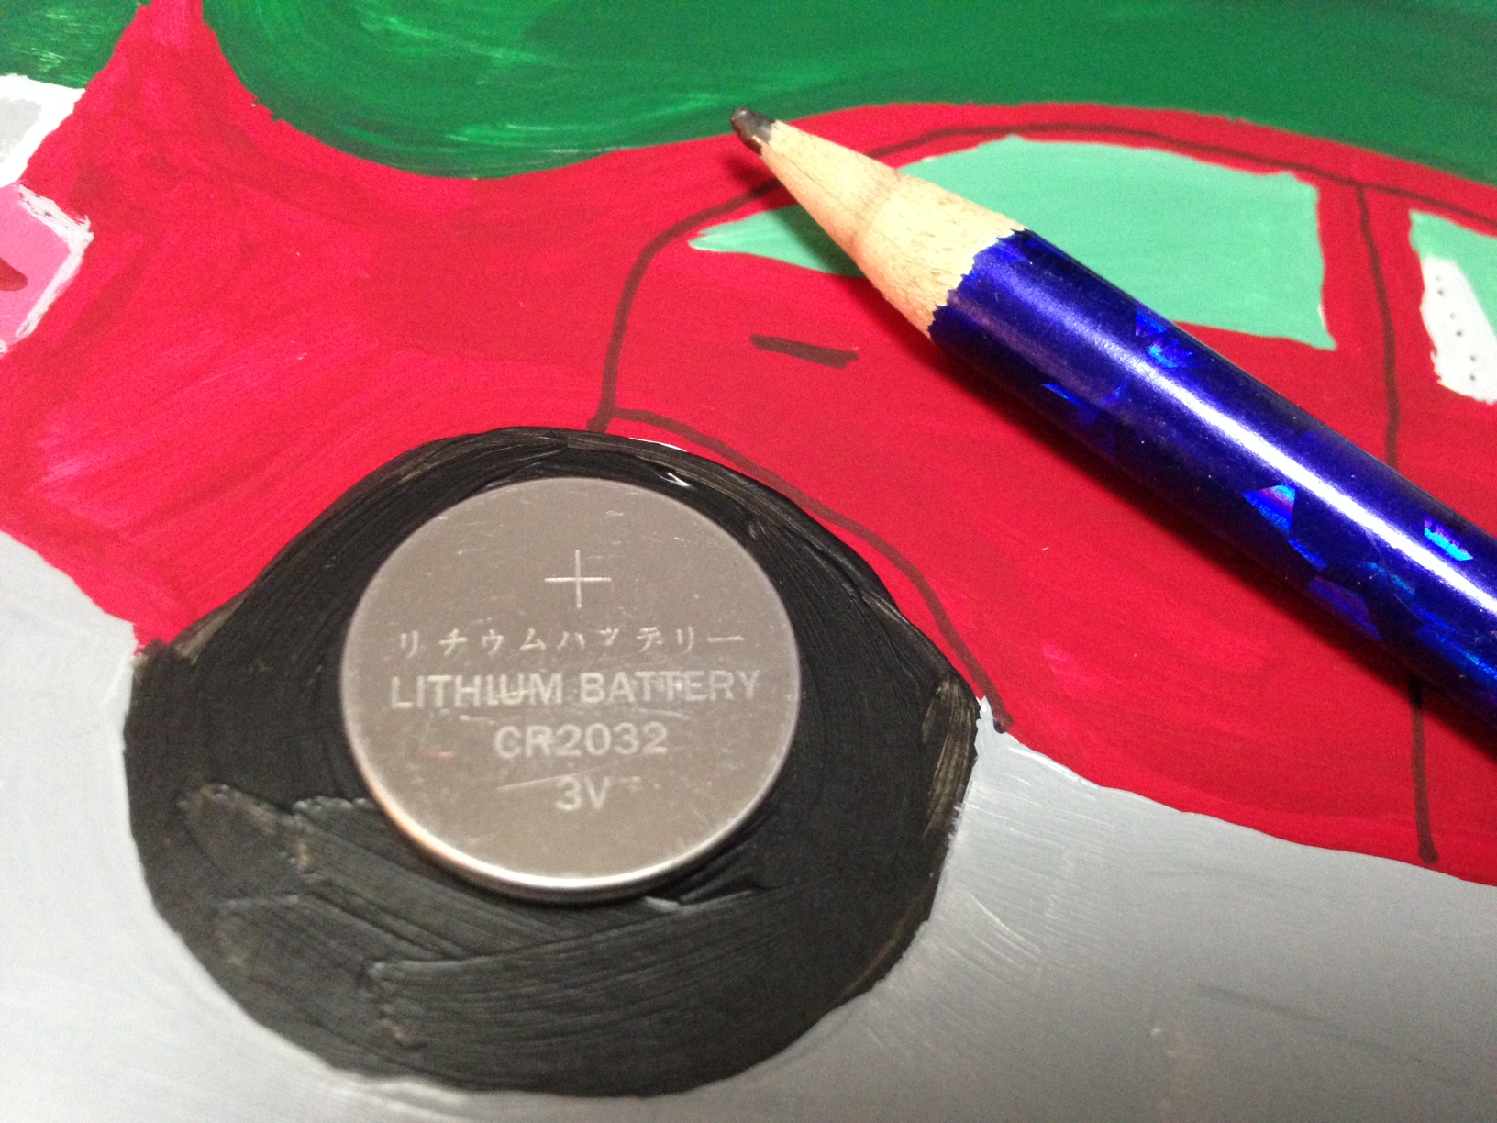
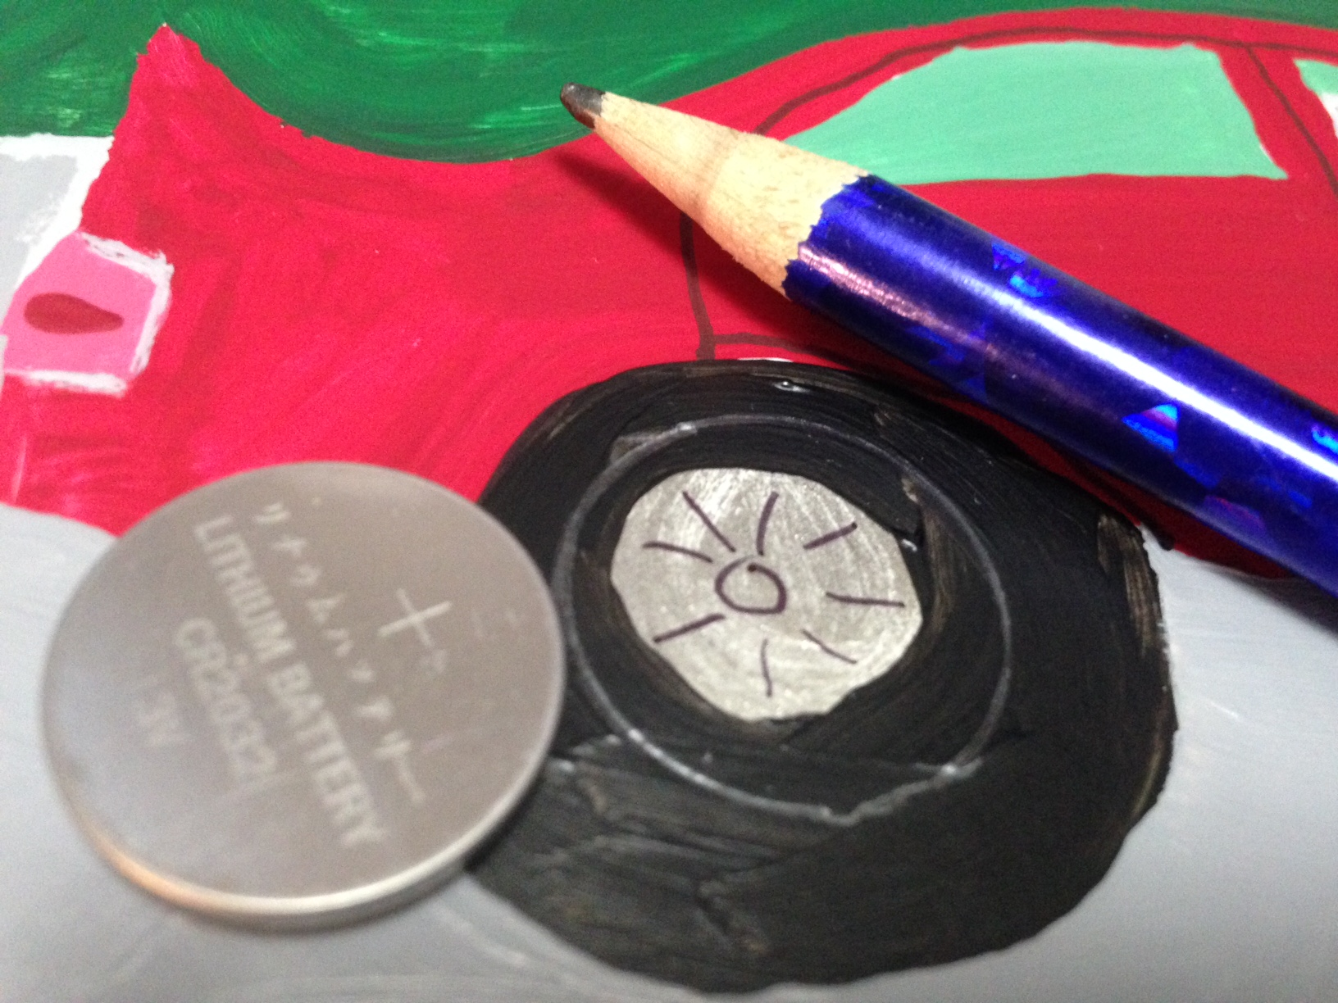
2) Trace battery where you want your button to be.

Slide 4
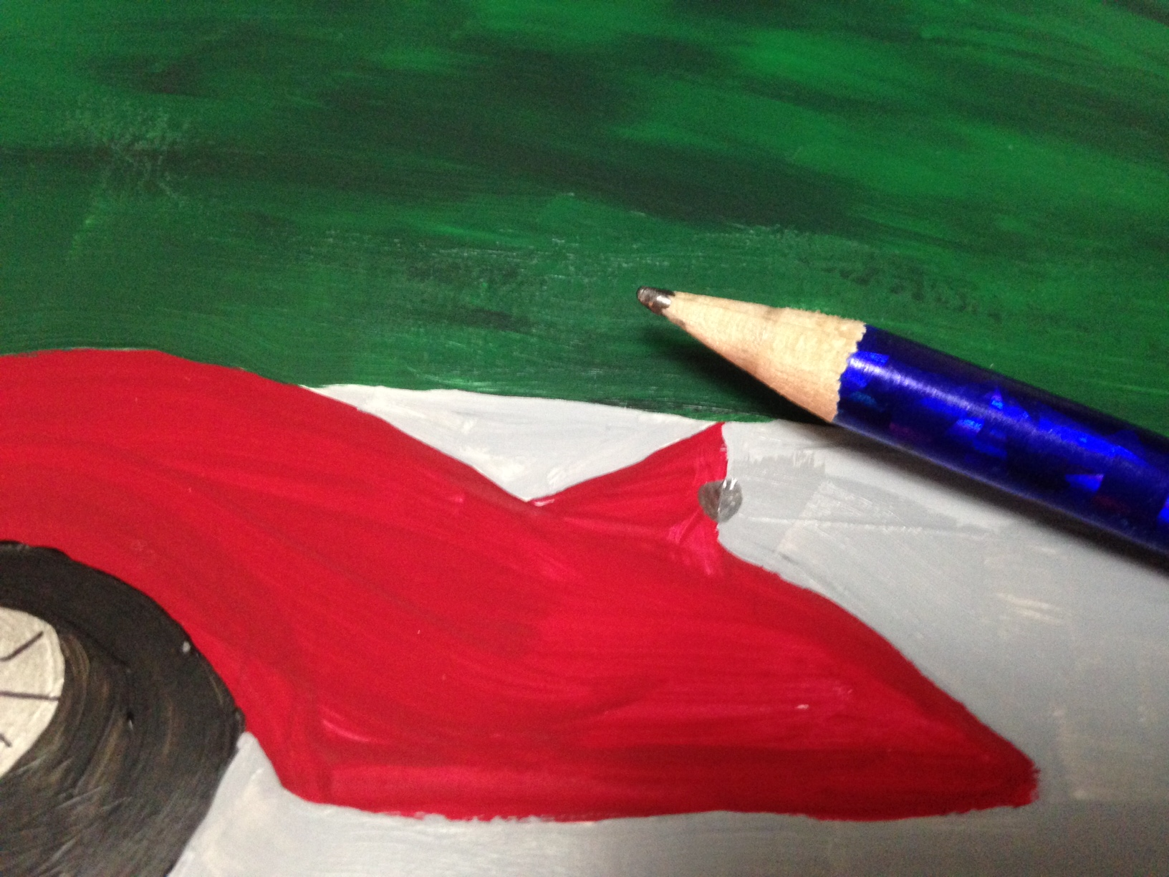
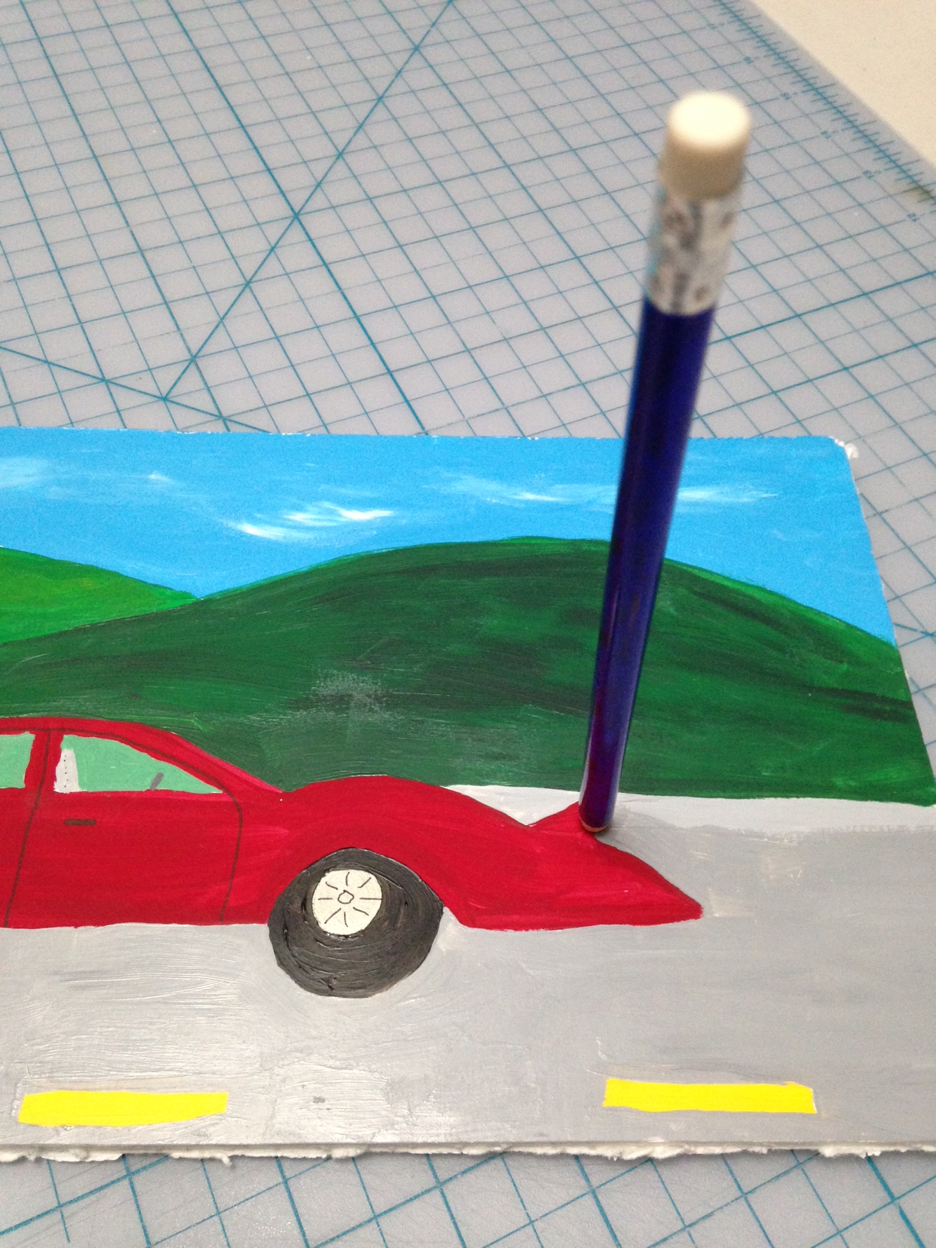
3) Poke a small hole for the LED.

Slide 5
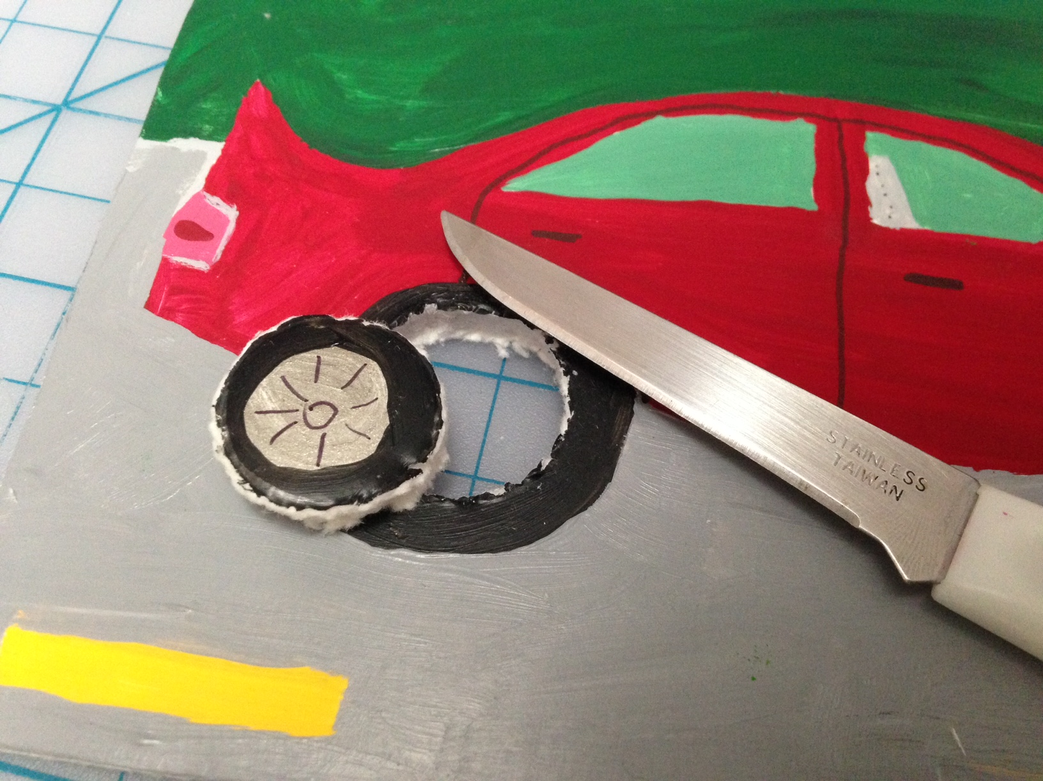
4) Ask an adult to cut the hole for the button.

Slide 6
5) Get to know your LED

Slide 7
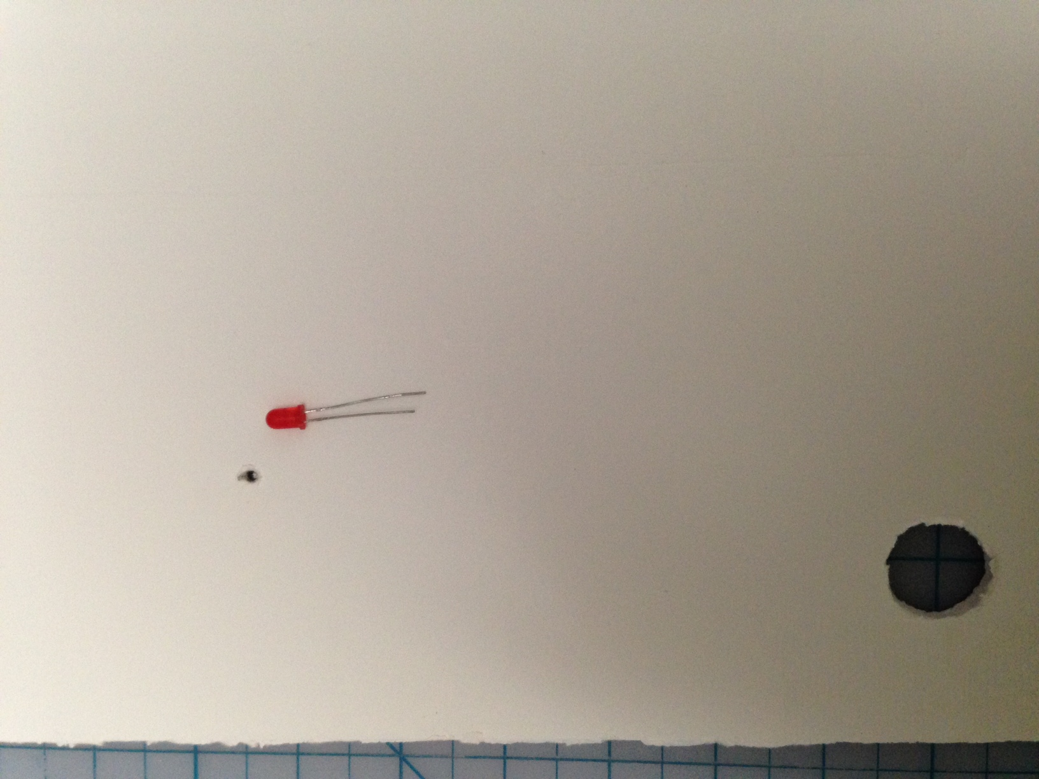
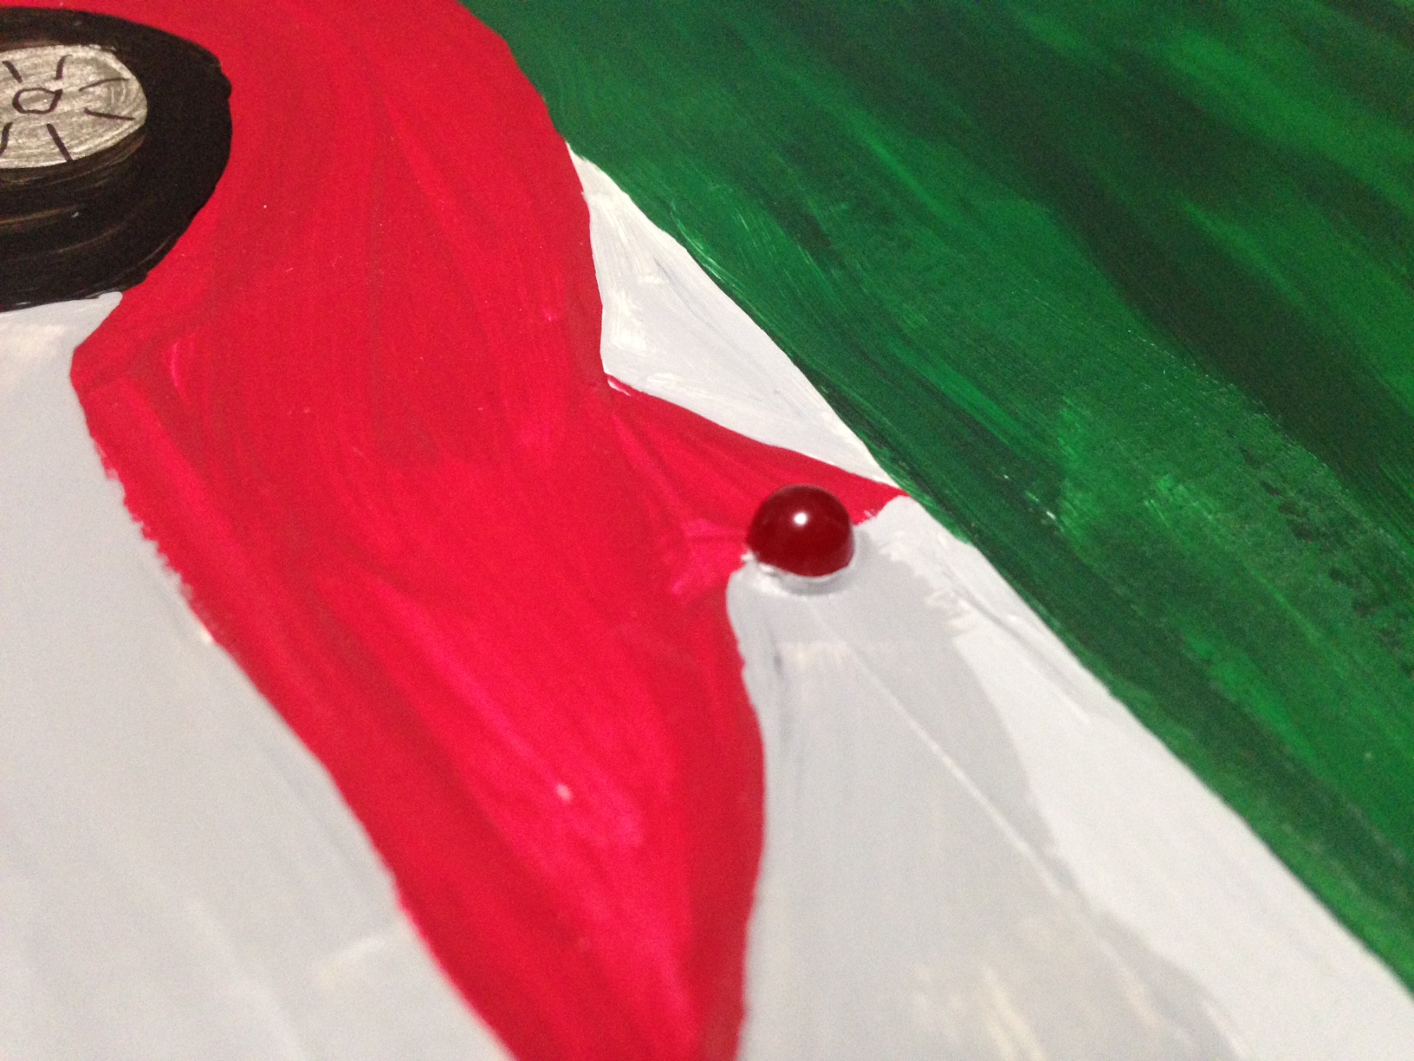
6) Insert the LED from the back.

Slide 8
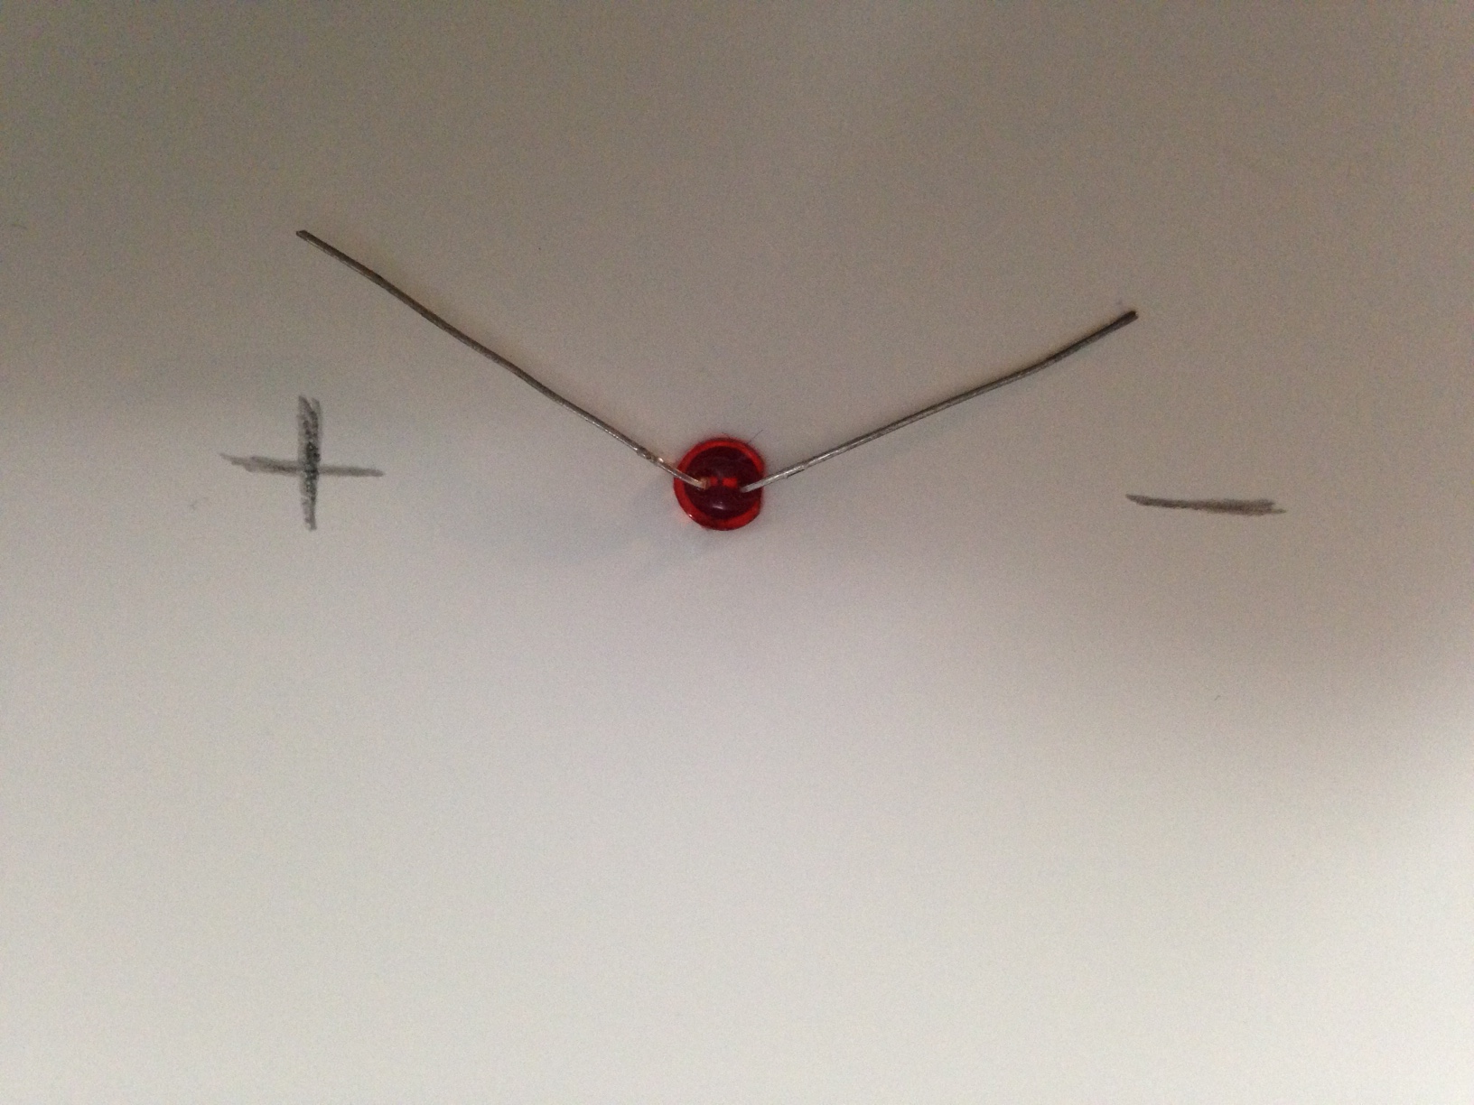
7) Bend the leads (wires) flat and label with – and +

Slide 9
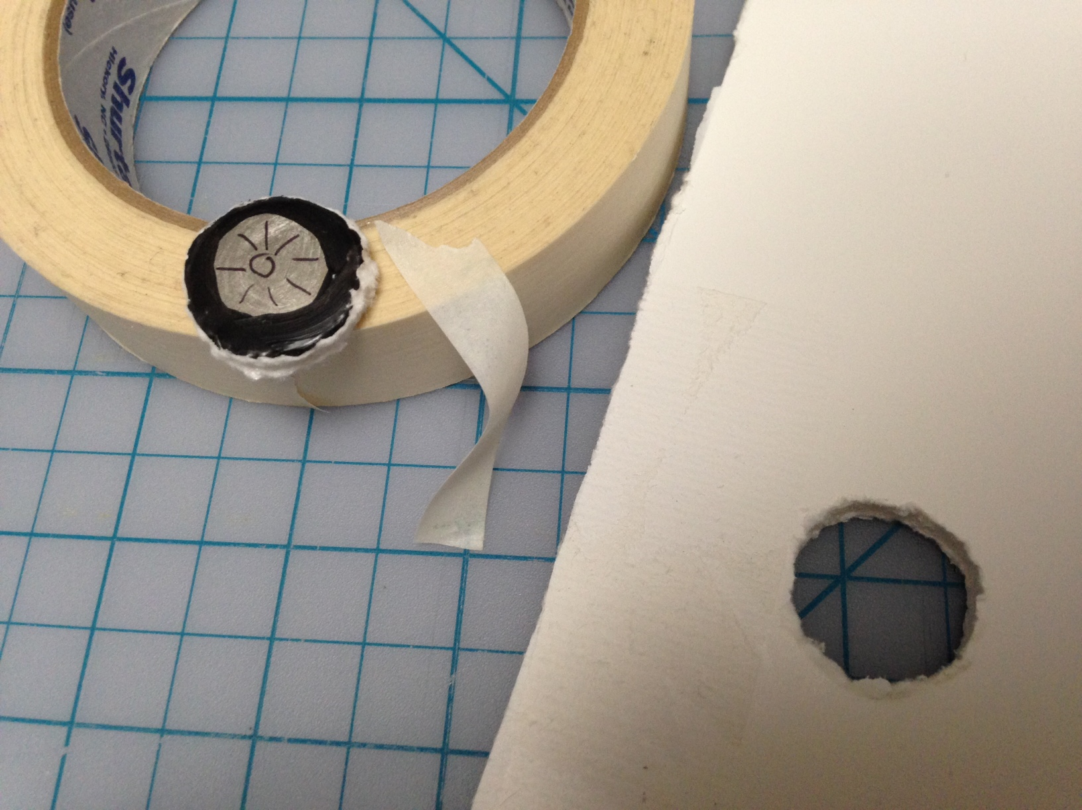
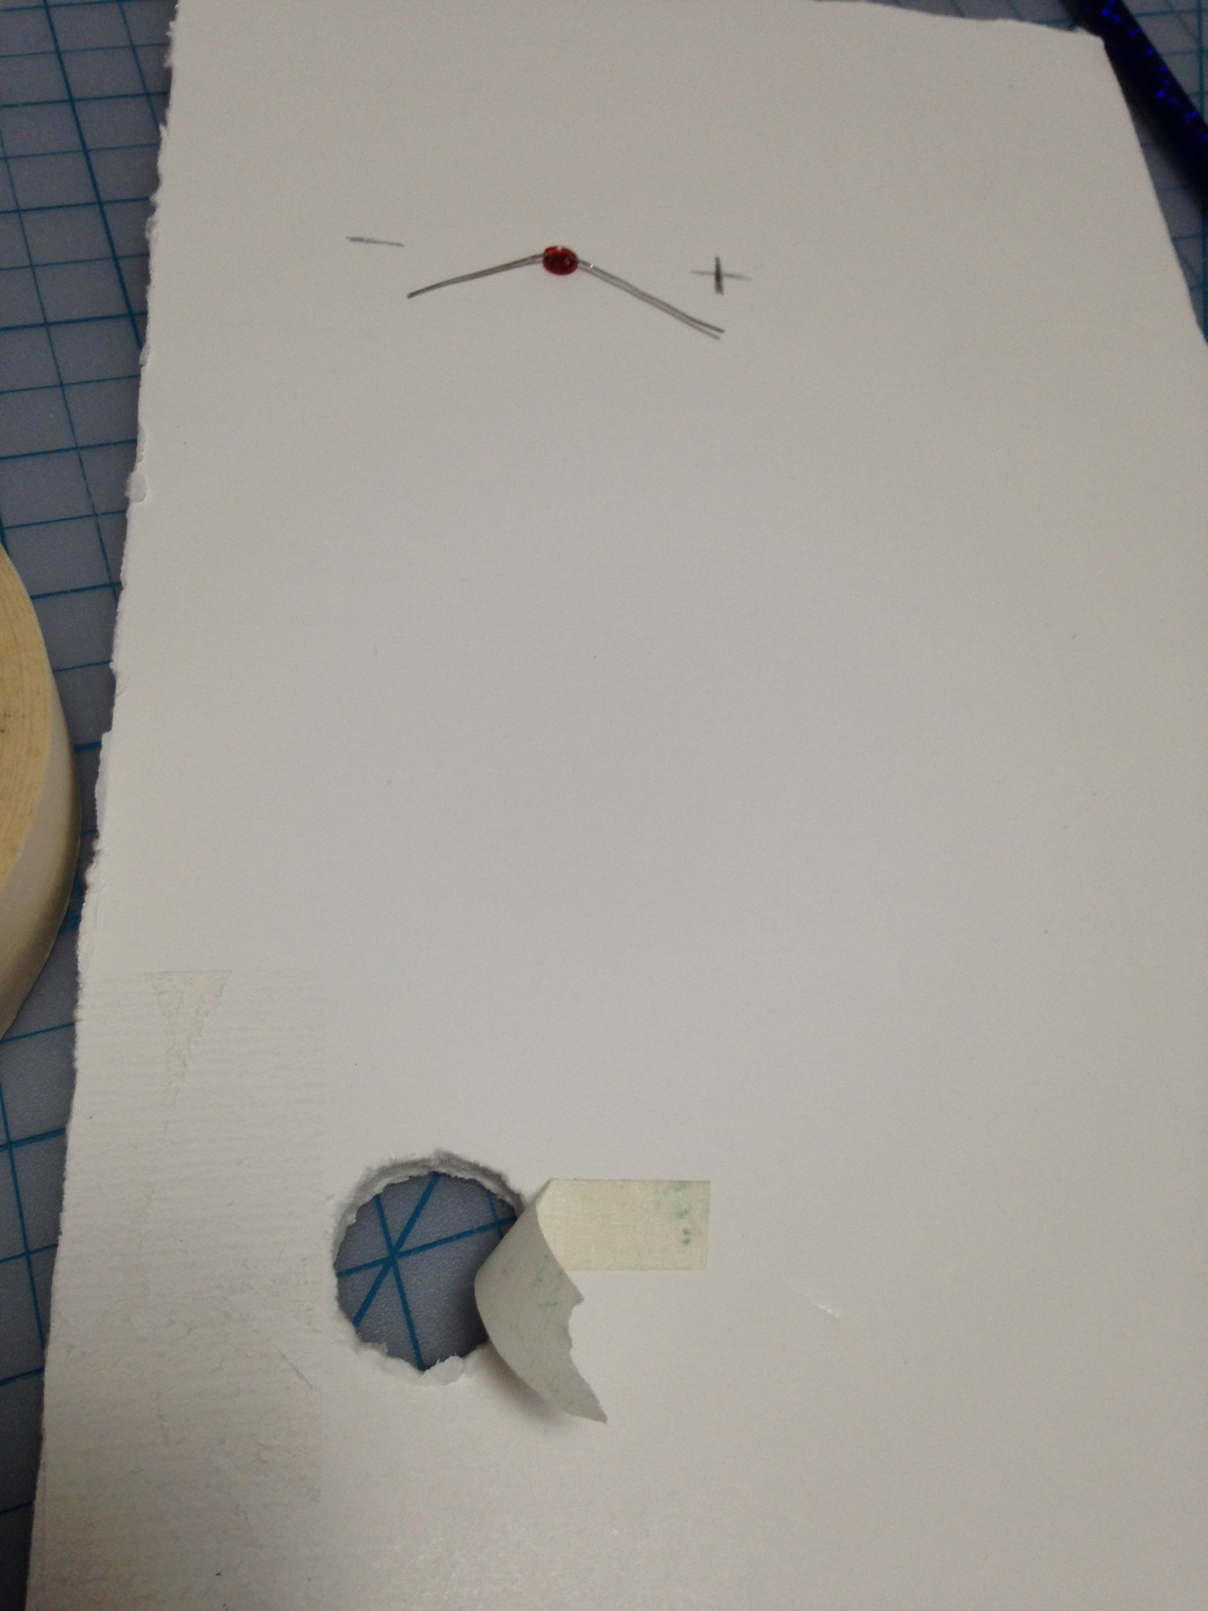
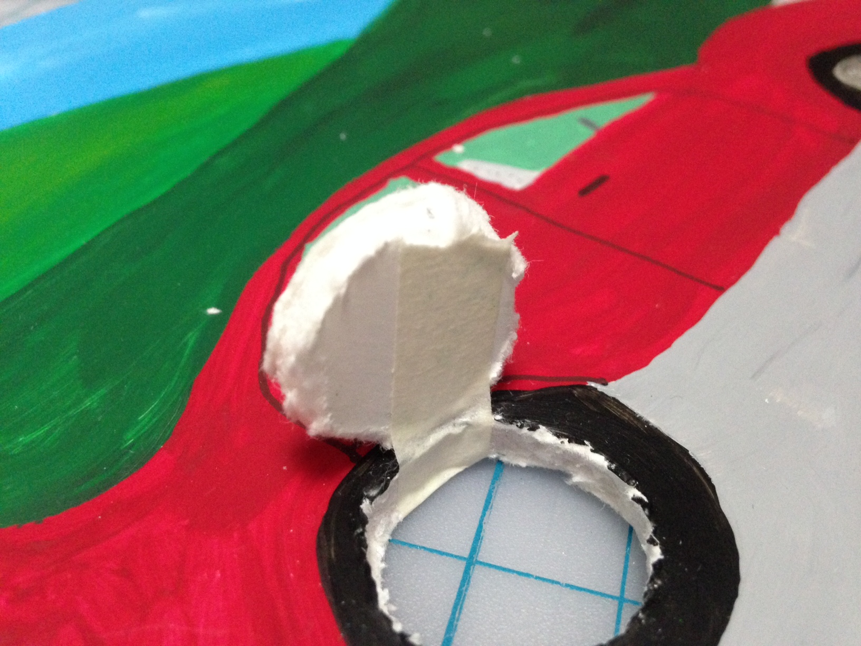
8) Add a masking tape hinge for your button.

Slide 10
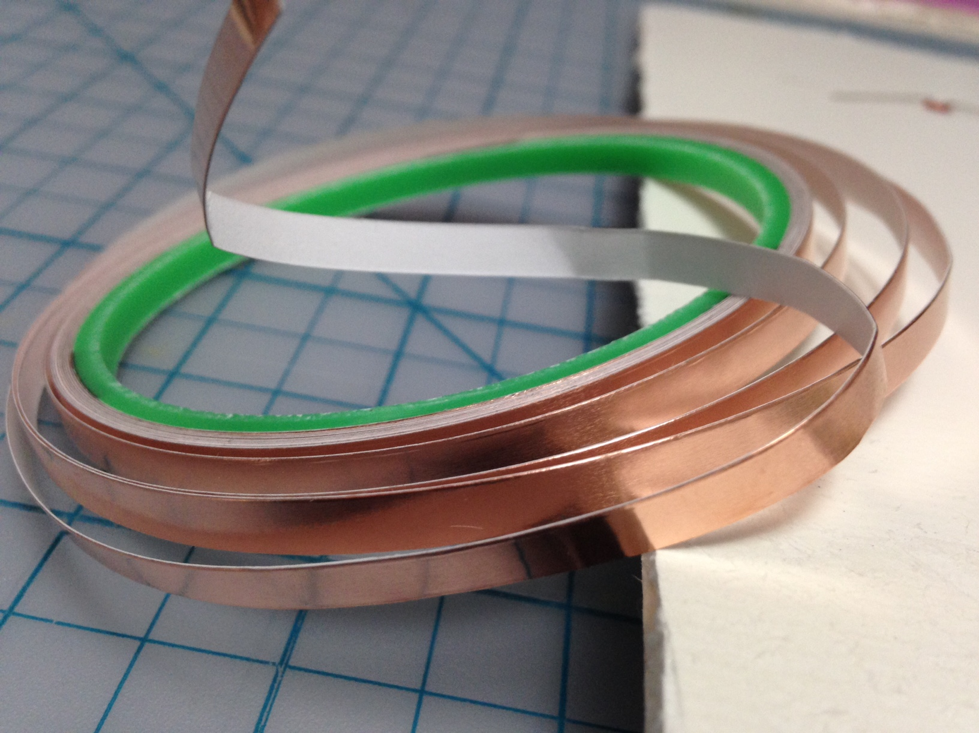
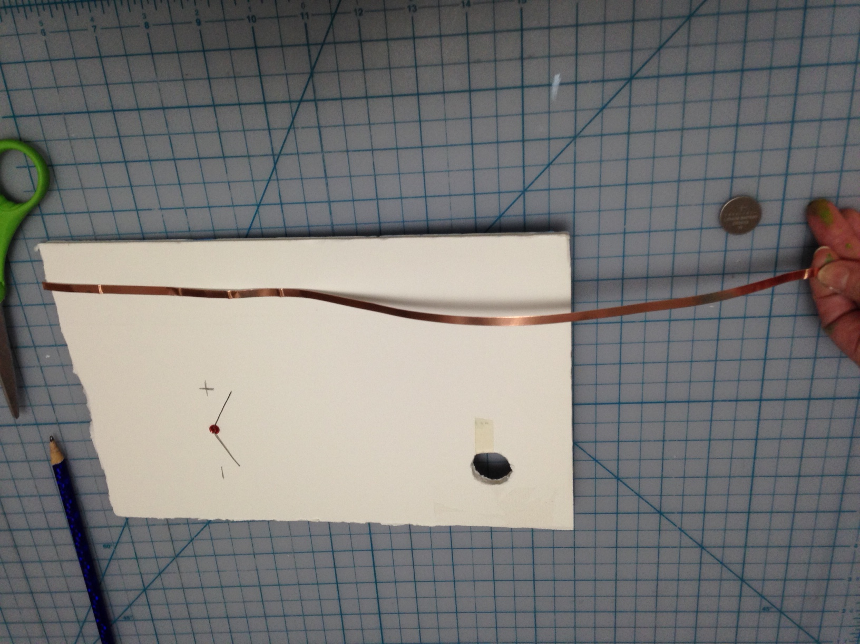
9) Get two pieces of copper tape. Be sure they are a bit longer than your board.

Slide 11
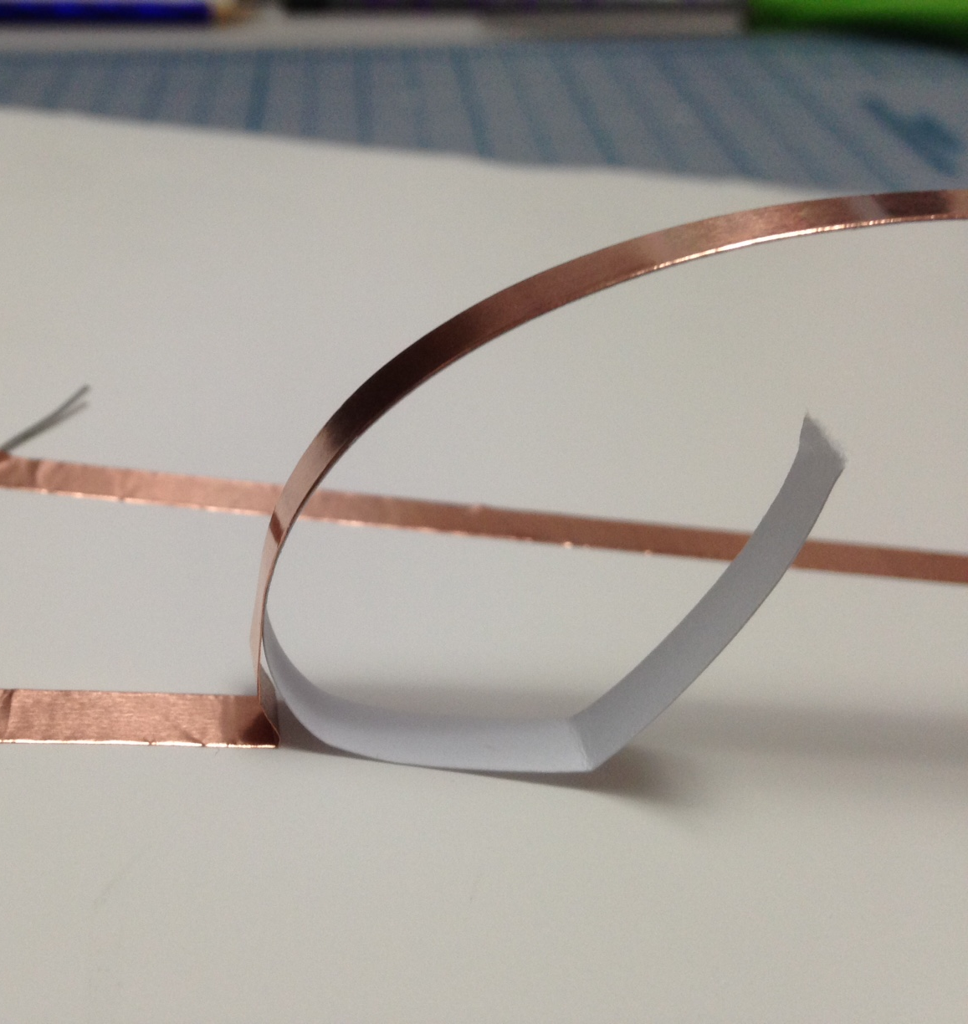
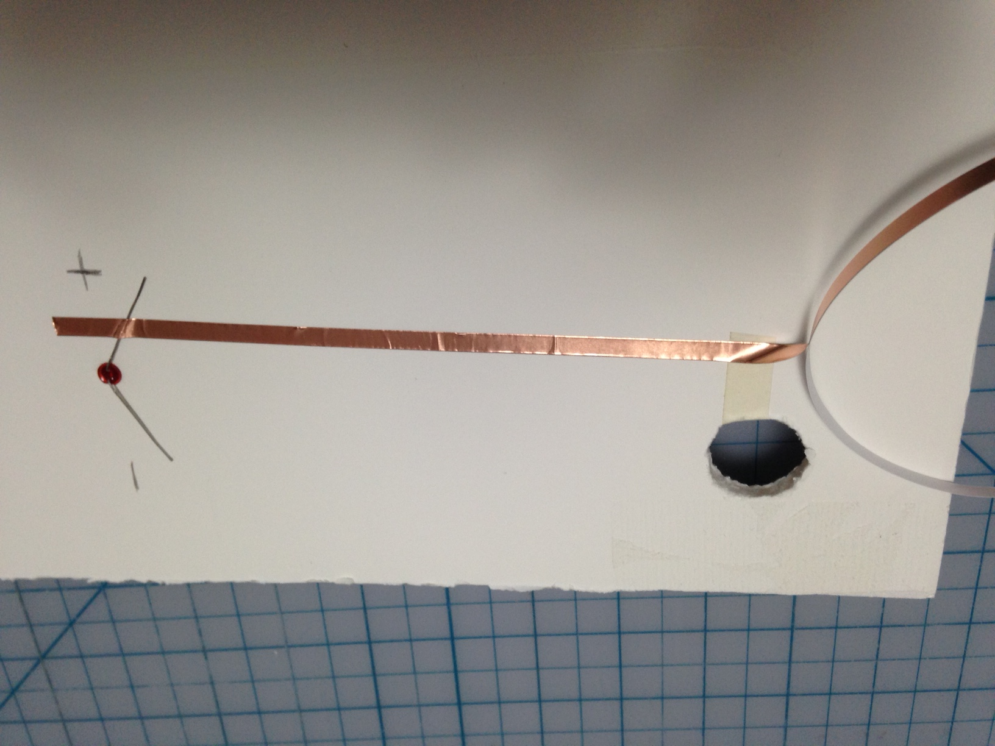
10) Start by crossing over the + lead. Do NOT tear the metal tape… you need this one long piece to go all the way to your button and battery.
Tip: peel backing as you
attach the tape and you can get
smooth, straight lines.

Slide 12
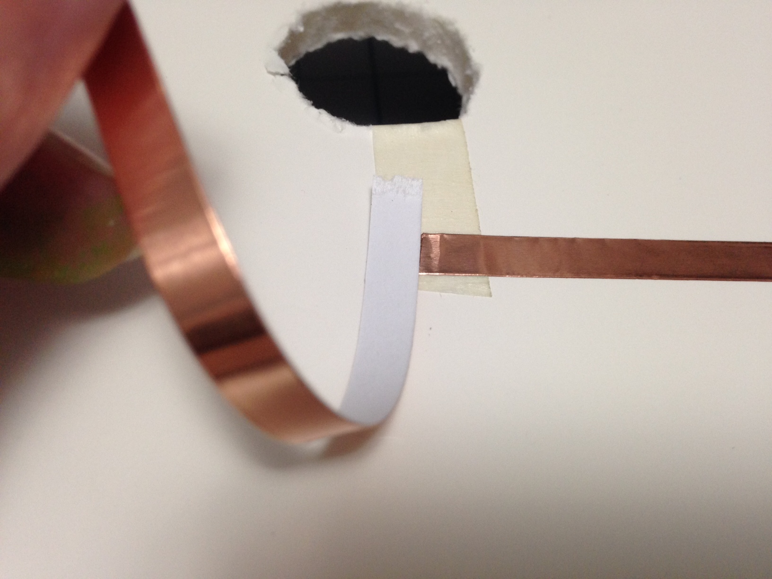
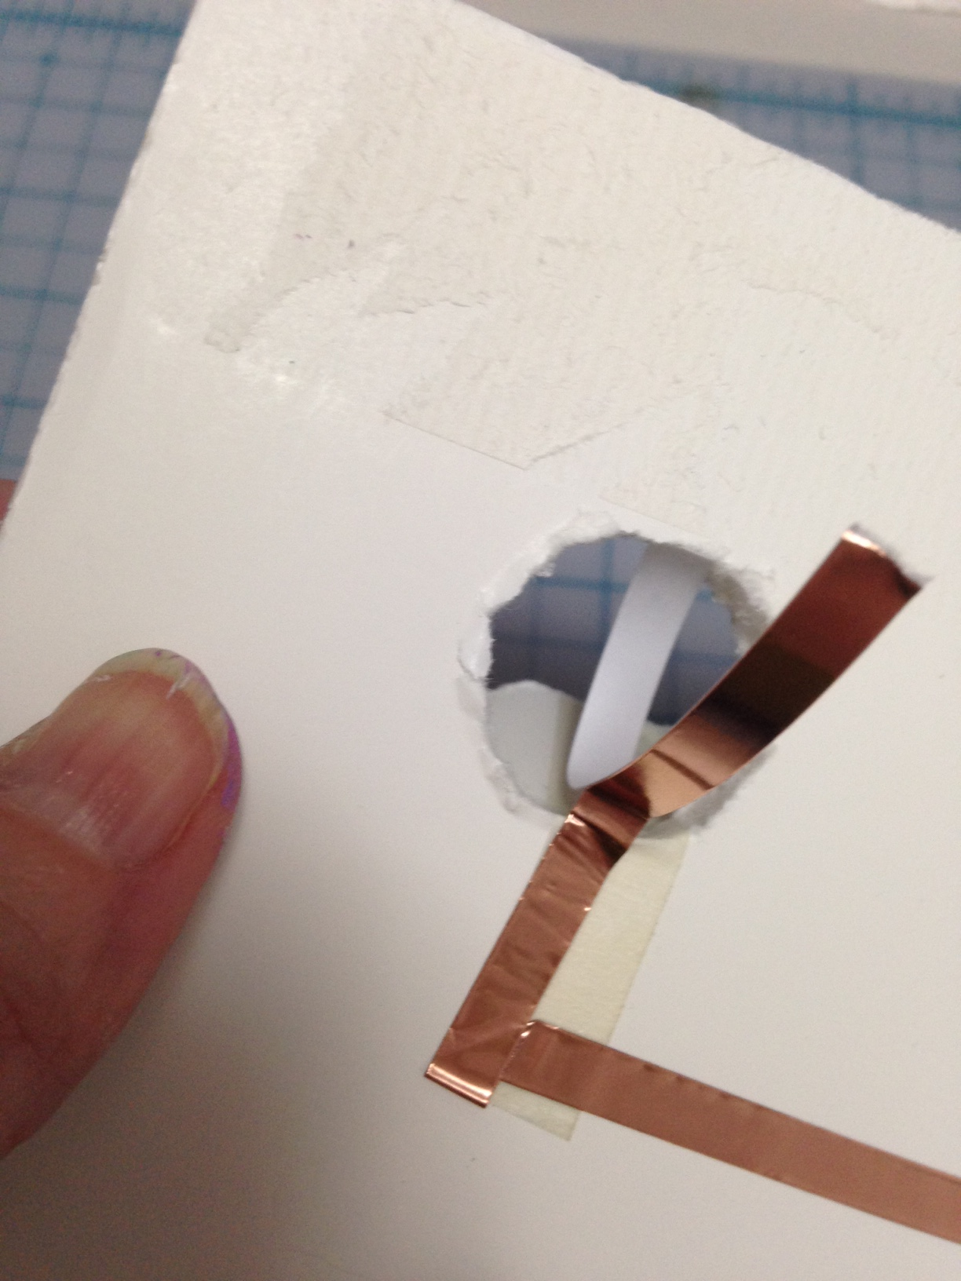
11) Carefully bend and fold the tape and attach the end to the underside of your button.
Be sure to put the metal tape
right on top of the masking tape hinge.

Slide 13
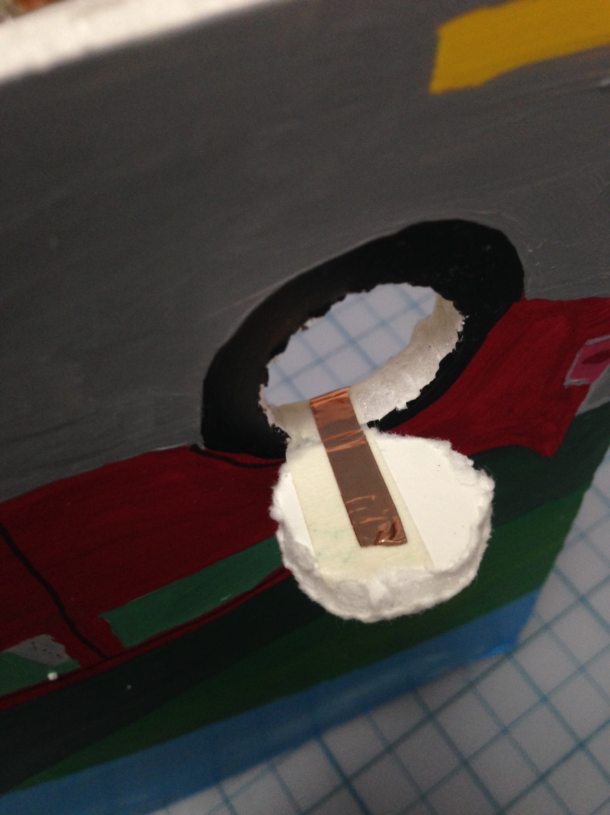
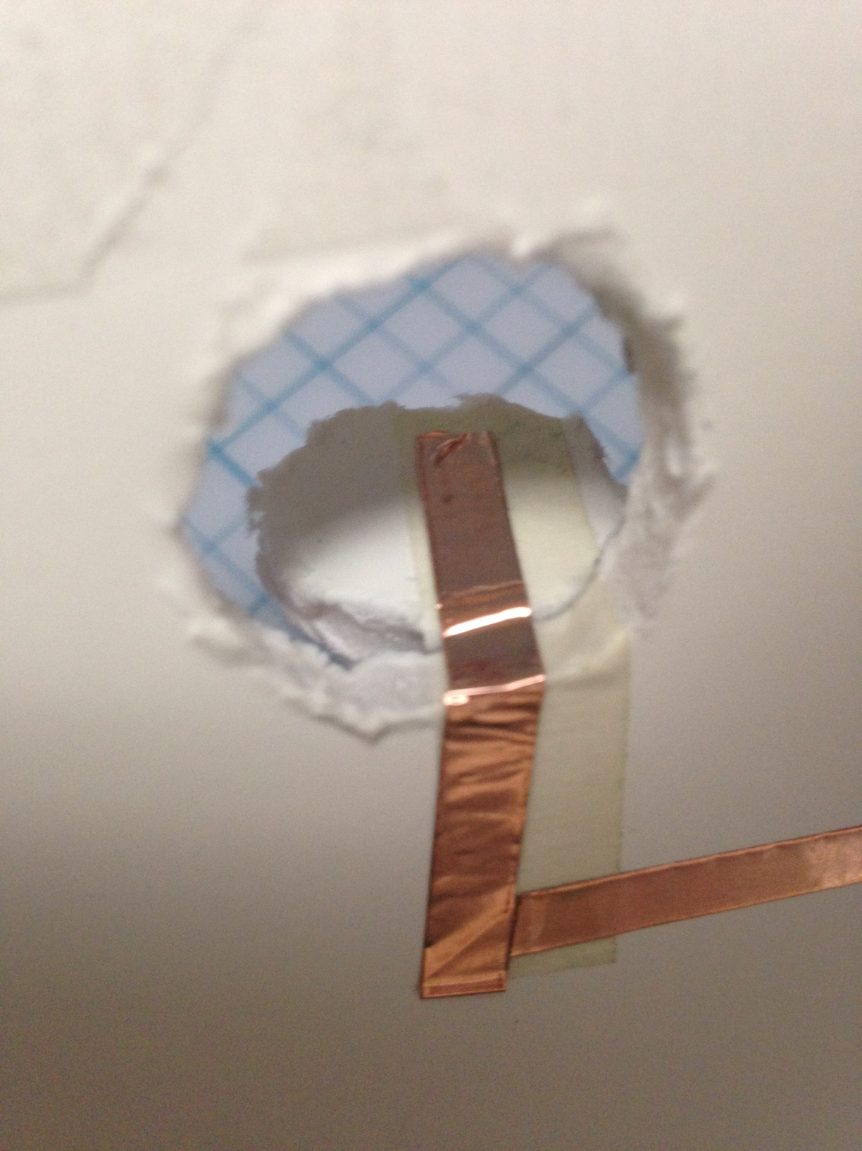
12) The taped button should look like this.

Slide 14
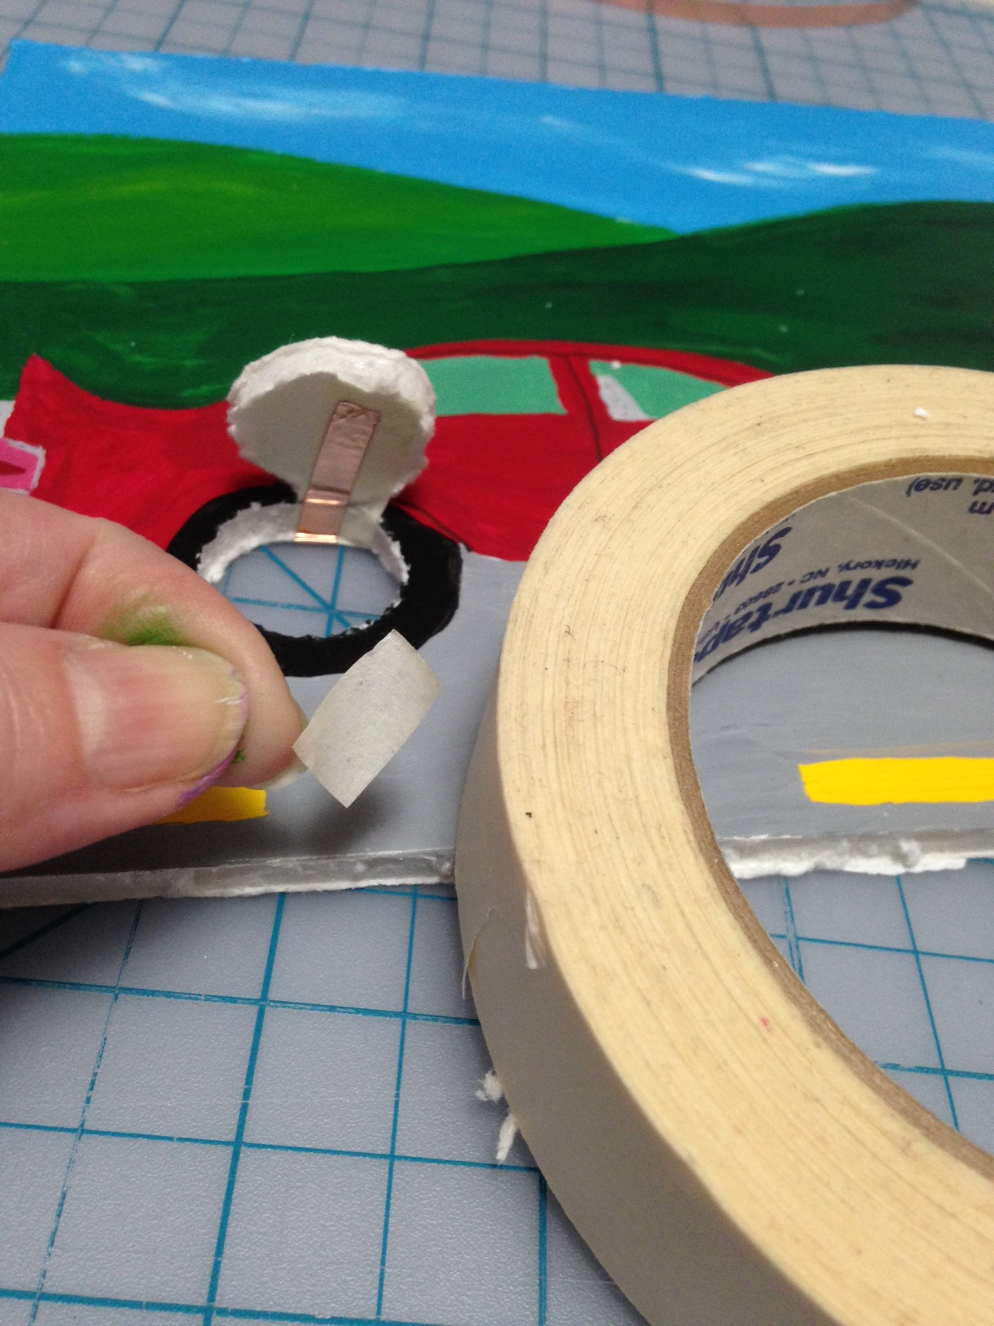
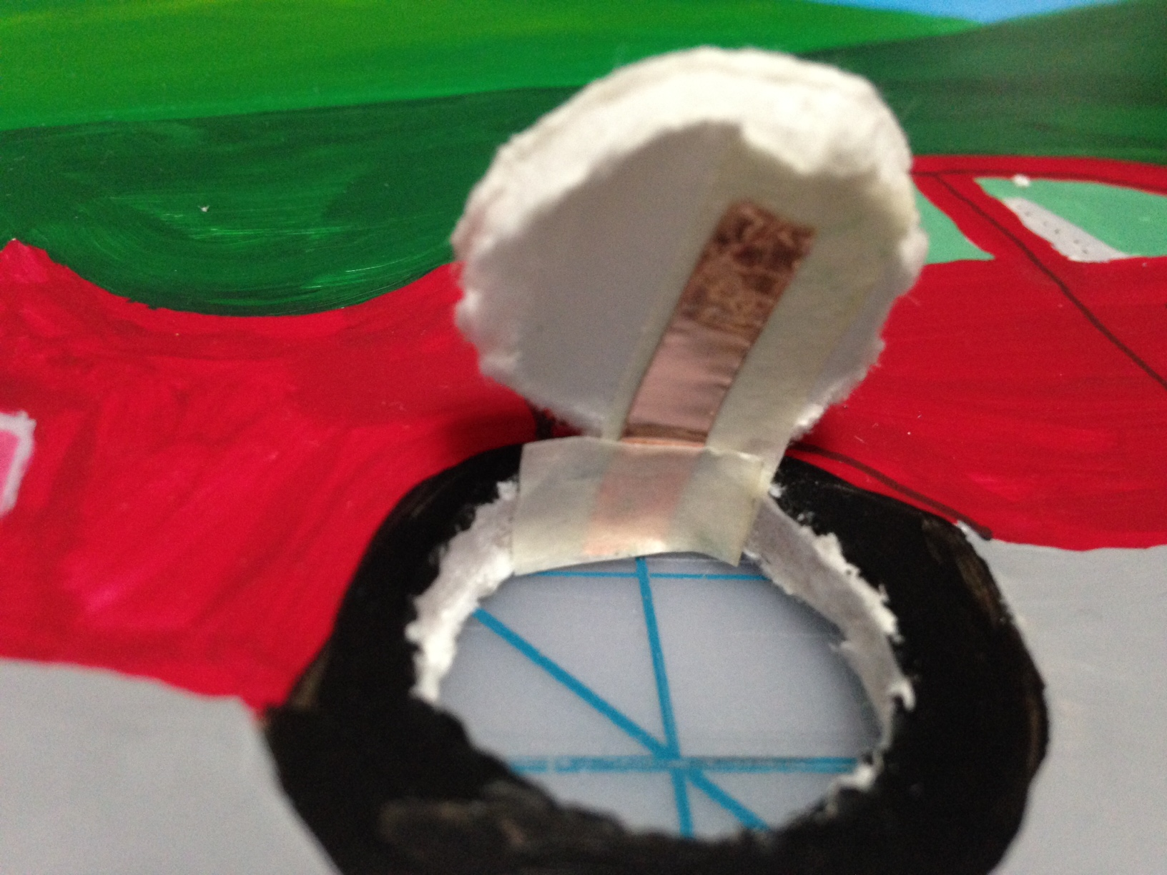
13) Use a small piece of masking tape to cover the metal tape near the foam.

Slide 15
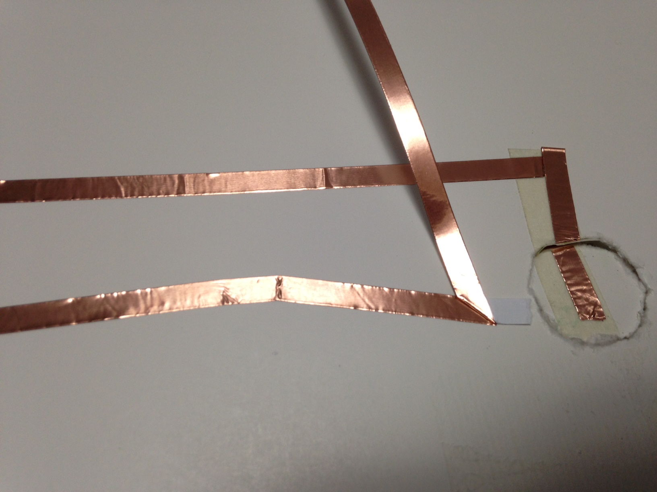
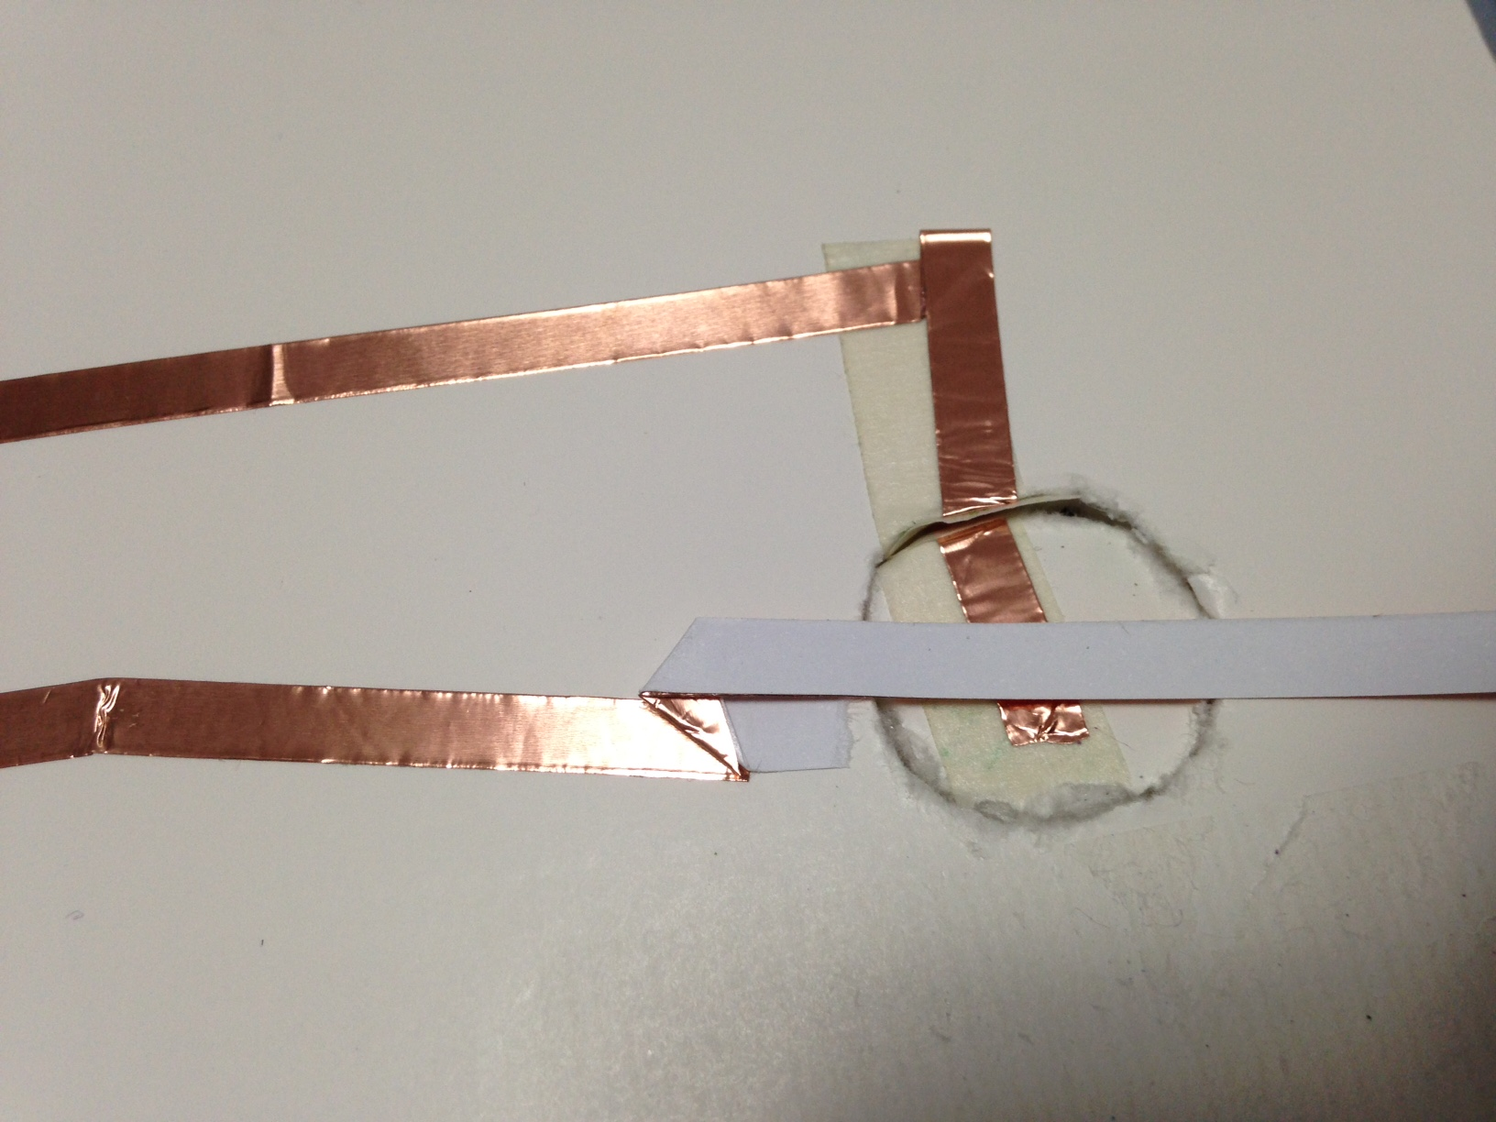
14) Carefully fold the metal tape so that the sticky side (with paper backing) is facing up.

Slide 16
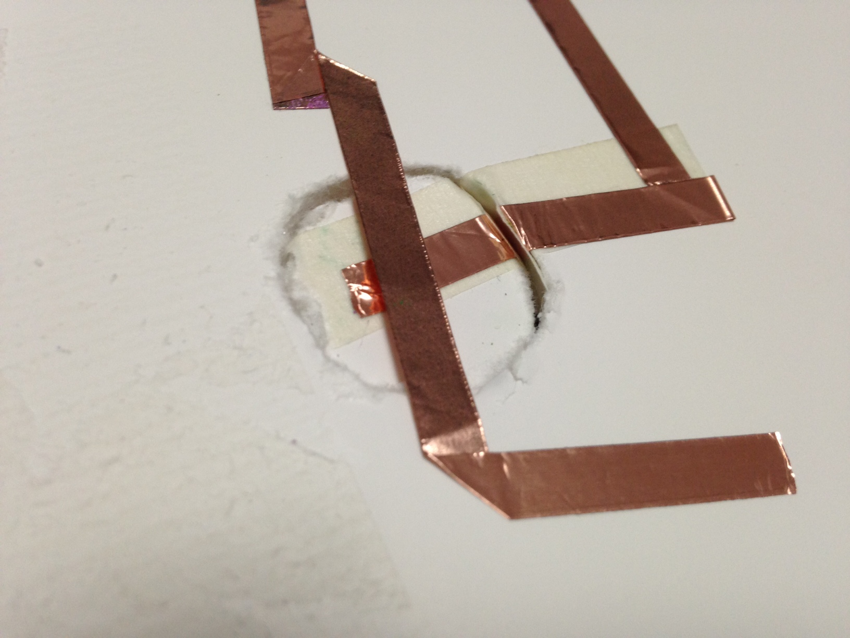
15) a- Cross metal tape over the hole for the button. b- Carefully fold so that the sticky side is down again. c- Attach the end of the metal tape to the board.

Slide 17
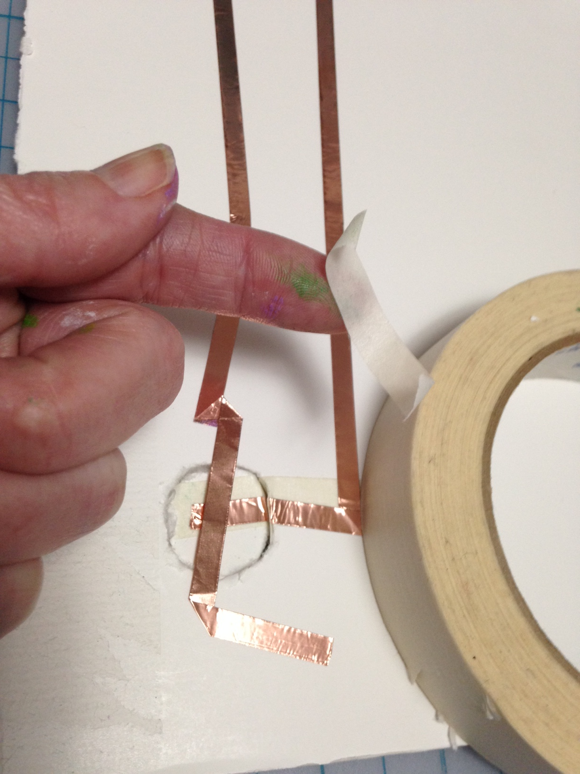
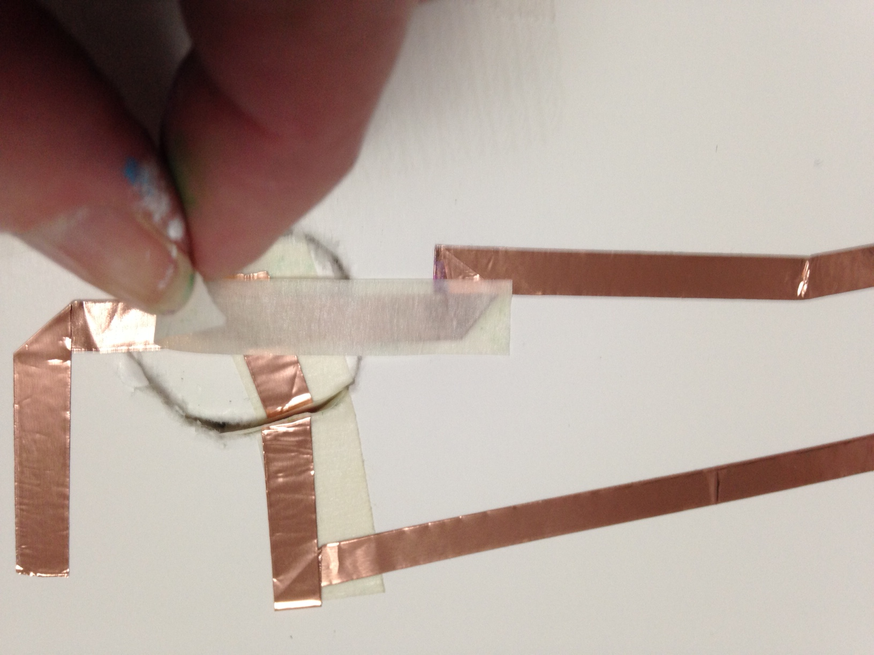
16) Use a skinny piece of masking tape to cover the sticky part of the metal tape.

Slide 18
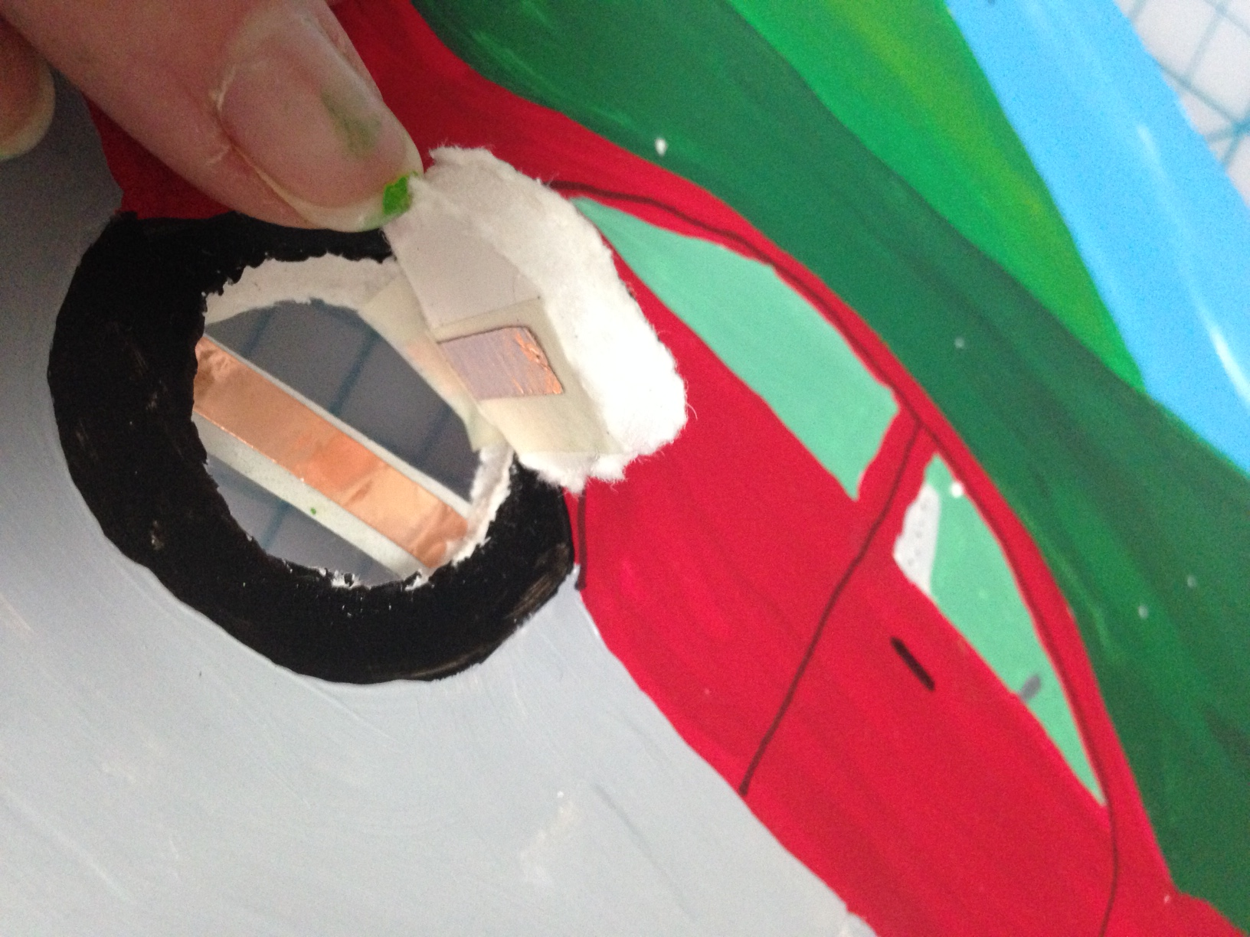
17) The inside of the button space should look like this.

Slide 19
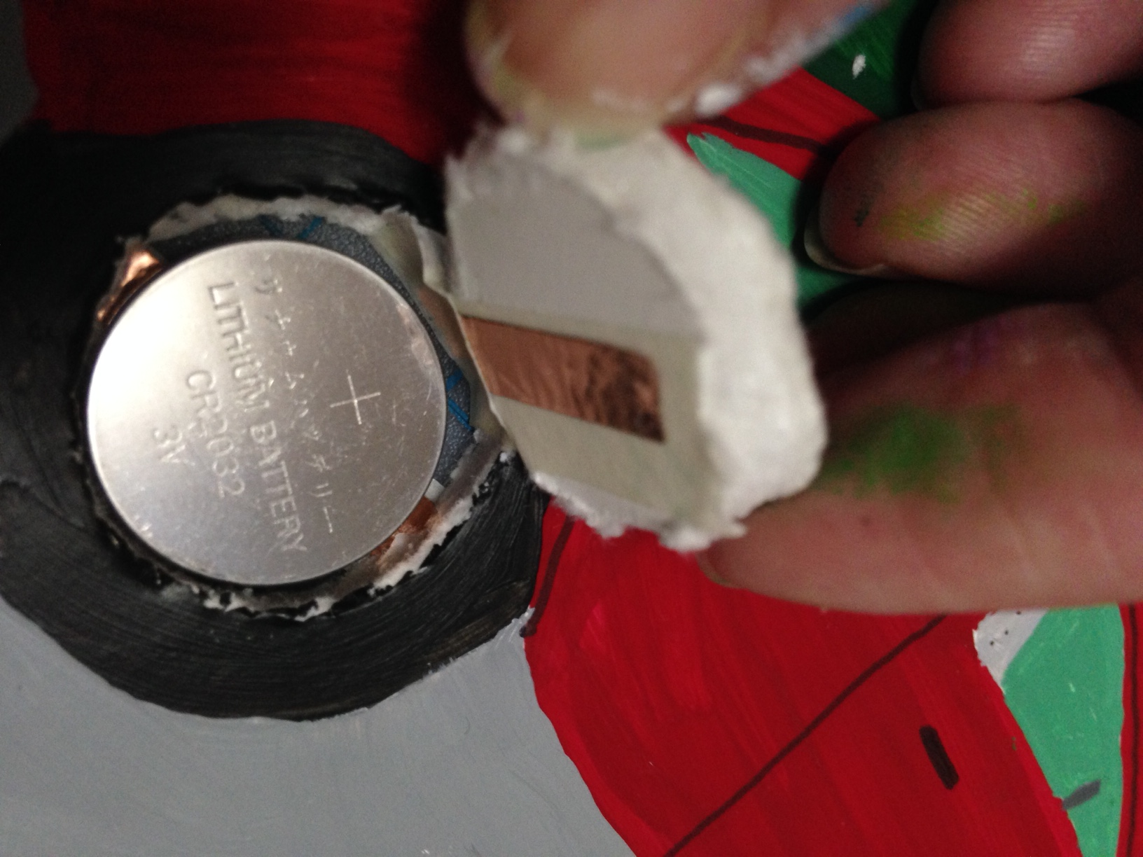
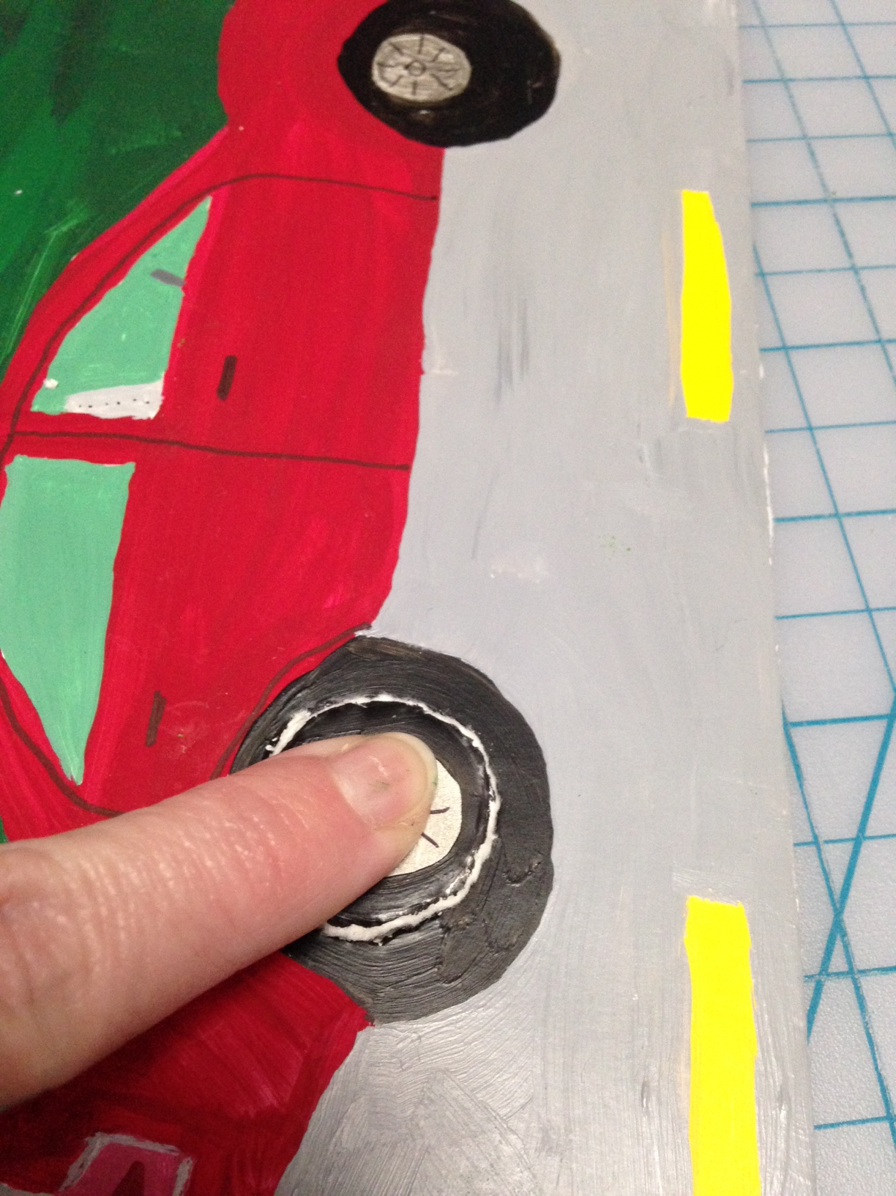
18) Put the battery in with the words (+ side) facing up.
Press the button to
make sure your circuit
is working.

Slide 20
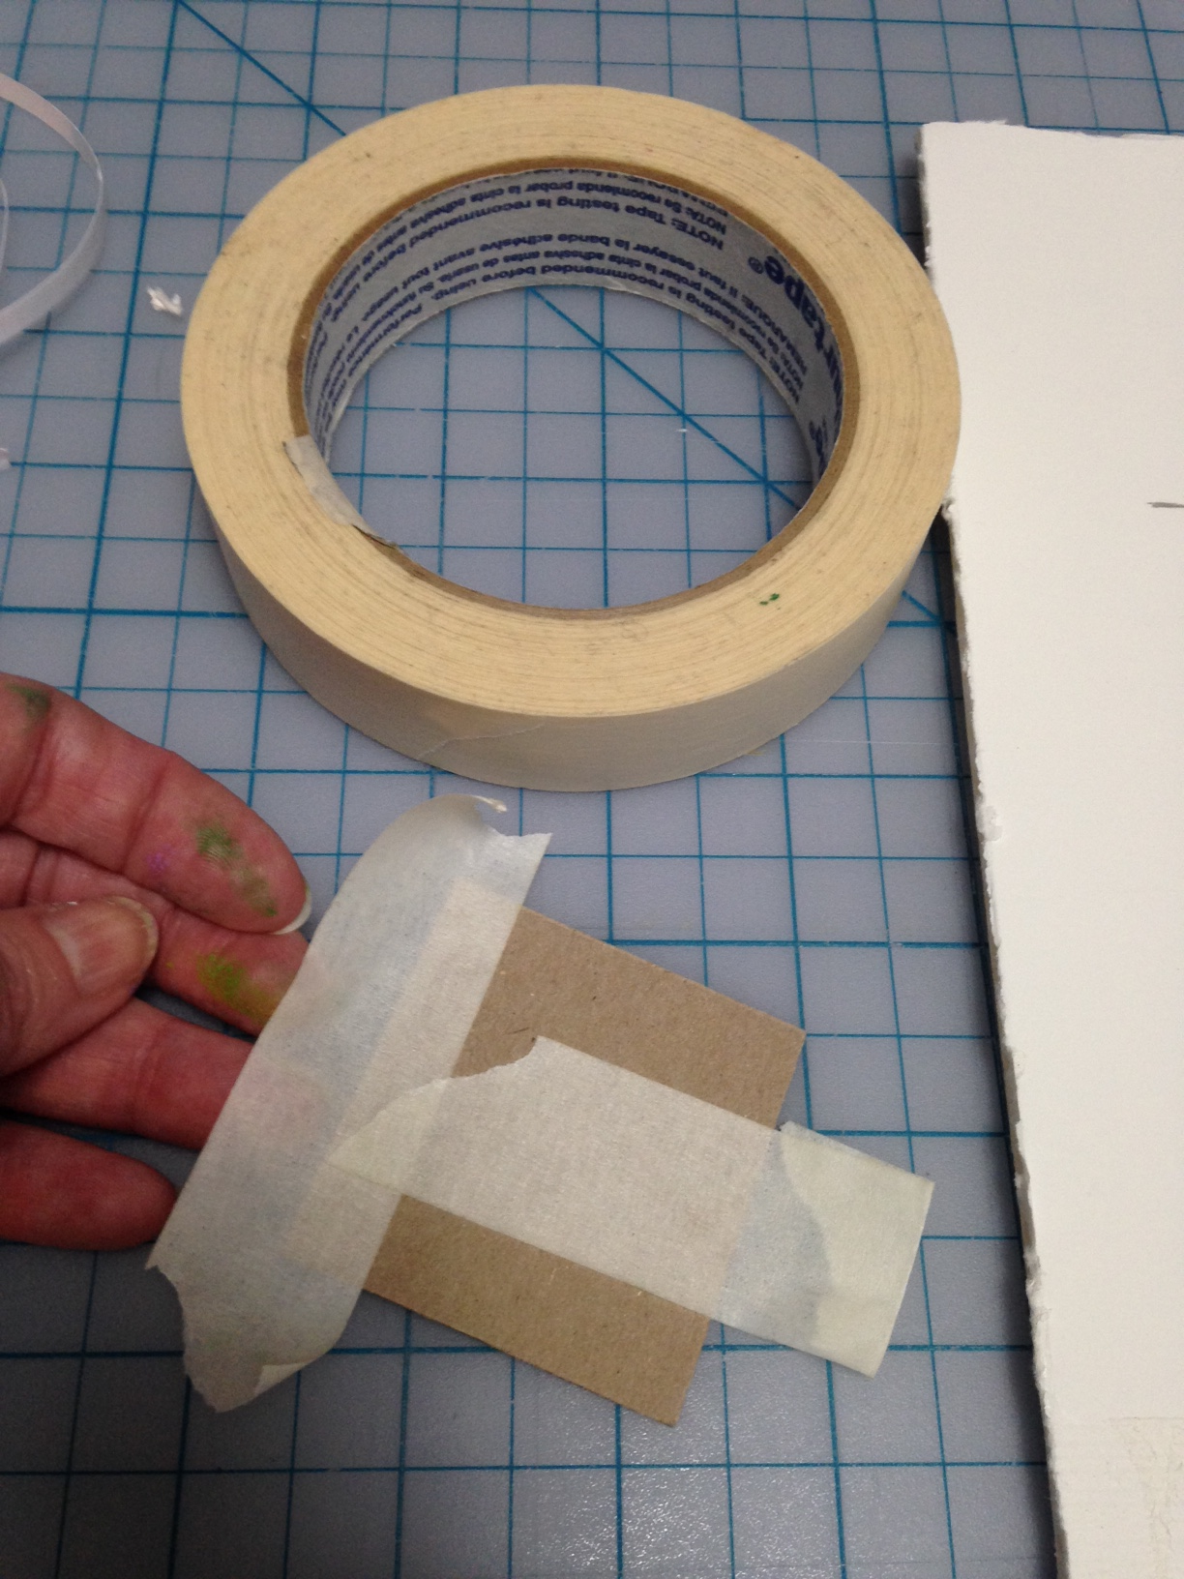
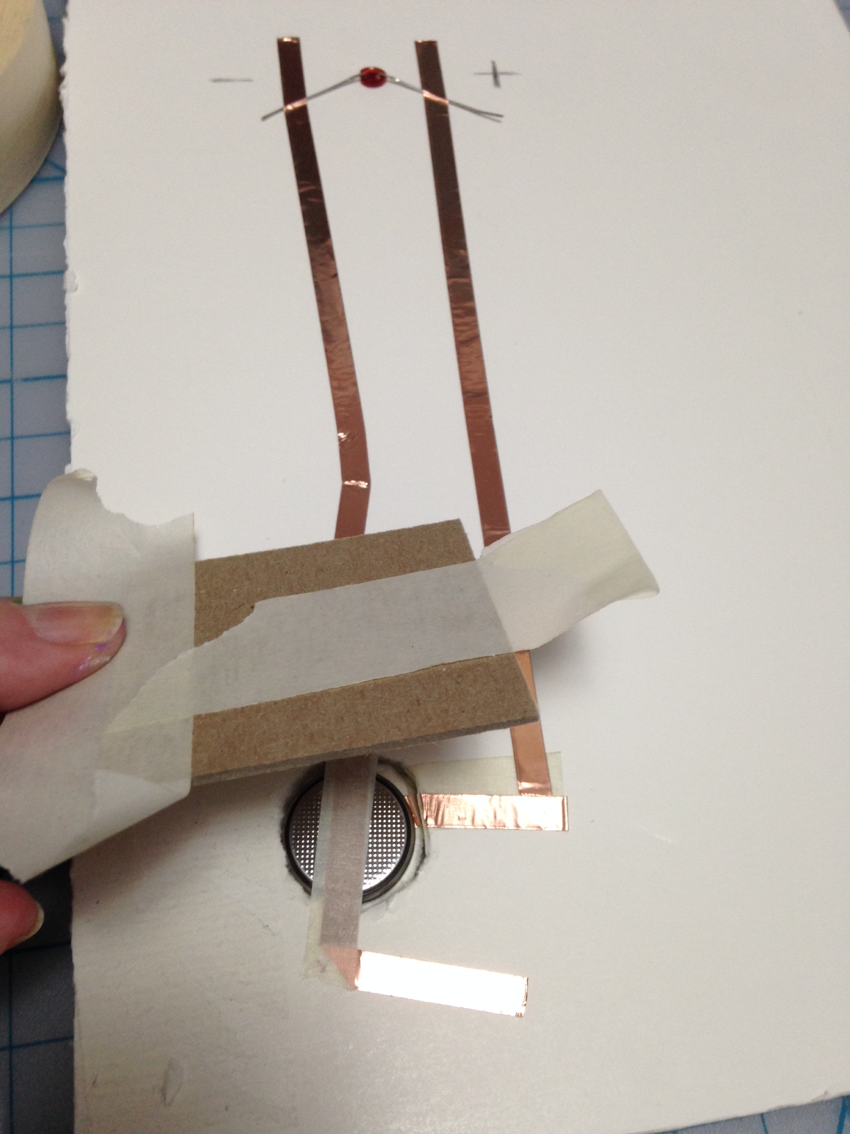
19) If it works well… you can tape a stiff paper or thin board over the battery to help support it and keep it in place.

